Slide 1

Layouts and Containers
Flow, Grid, and Border
Nesting Layouts
JPanel, JFrame
JTabbedPane, JSplitPane

Slide 2

See Also
https://docs.oracle.com/javase/tutorial/uiswing/layout/visual.html
https://www.youtube.com/watch?v=mgnWYBaJuUk
Notes:
Some additional information on concurrency

Slide 3
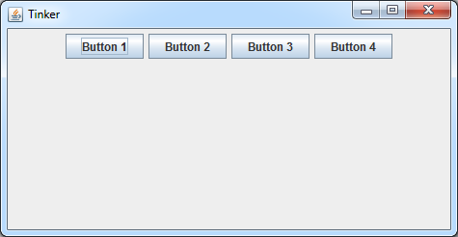
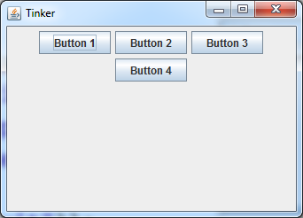
FlowLayout
Does not resize the components
Wraps components to the next row
Alignment and gaps
Alignment
(left, center, right)
JPanel pan = new JPanel(new FlowLayout());
pan.setLayout(new FlowLayout(a,h,v));
pan.add(new JButton("Button 1"));
pan.add(new JButton("Button 2"));
pan.add(new JButton("Button 3"));
pan.add(new JButton("Button 4"));
JFrame jf = new JFrame("Tinker");
jf.setContentPane(pan);
jf.setDefaultCloseOperation(JFrame.DISPOSE_ON_CLOSE);
jf.setSize(640,480);
jf.setVisible(true);
vgap
hgap

Slide 4
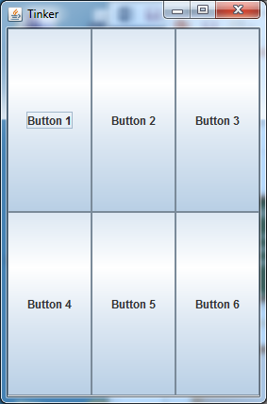
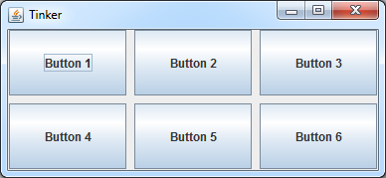
GridLayout
Divides width into even columns
Divides height into even rows
Resizes components to fit cells
JPanel pan = new JPanel(new GridLayout(2,3));
new GridLayout(nr,nc,hgap,vgap);
pan.add(new JButton("Button 1"));
pan.add(new JButton("Button 2"));
pan.add(new JButton("Button 3"));
pan.add(new JButton("Button 4"));
pan.add(new JButton("Button 5"));
pan.add(new JButton("Button 6"));
hgap
vgap

Slide 5
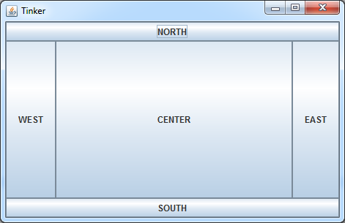
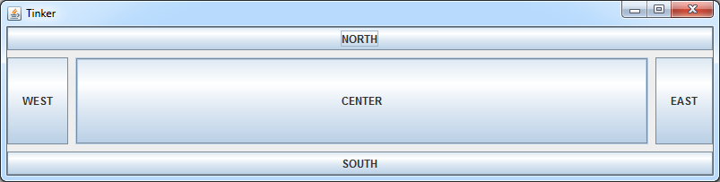
BorderLayout
Creates zones around a center
Vertical resize: WEST and EAST
Horiz. resize: NORTH and SOUTH
JPanel pan = new JPanel(new BorderLayout());
new BorderLayout(hgap,vgap);
pan.add(new JButton("EAST"), "East");
pan.add(new JButton("WEST"), BorderLayout.WEST);
pan.add(new JButton("NORTH"), BorderLayout.NORTH);
pan.add(new JButton("SOUTH"), BorderLayout.SOUTH);
pan.add(new JButton("CENTER"), BorderLayout.CENTER);
hgap
vgap

Slide 6
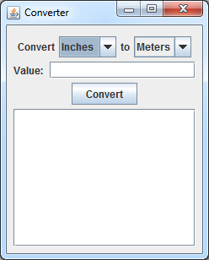







Converter Layout
panA
Flow
panTop
Border
NORTH
panB
Border
panMain
Border
CENTER
NORTH
WEST
CENTER
SOUTH
panC
Flow
CENTER
Scroll

Slide 7
public static void main(String[] args) {
JComboBox<String> from = new JComboBox<String>();
from.addItem("Inches");
from.addItem("Meters");
from.setSelectedIndex(0);
JComboBox<String> to = new JComboBox<String>();
to.addItem("Inches");
to.addItem("Meters");
to.setSelectedIndex(1);
JTextField value = new JTextField(15);
JTextArea history = new JTextArea(10,15);
JButton convert = new JButton("Convert");
JPanel panA = new JPanel(new FlowLayout());
panA.add(new JLabel("Convert"));
panA.add(from);
panA.add(new JLabel("to"));
panA.add(to);
JPanel panB = new JPanel(new BorderLayout());
panB.add(new JLabel("Value:"),BorderLayout.WEST);
panB.add(value,BorderLayout.CENTER);
JPanel panC = new JPanel(new FlowLayout());
panC.add(convert);
JPanel panTop = new JPanel(new BorderLayout());
panTop.add(BorderLayout.NORTH,panA);
panTop.add(BorderLayout.CENTER,panB);
panTop.add(BorderLayout.SOUTH, panC);
JPanel panMain = new JPanel(new BorderLayout());
panMain.add(BorderLayout.NORTH,panTop);
panMain.add(BorderLayout.CENTER,history);
JFrame jf = new JFrame("Converter");
jf.setContentPane(panMain);
jf.setDefaultCloseOperation(JFrame.DISPOSE_ON_CLOSE);
jf.setSize(250,320);
jf.setVisible(true);
}

Slide 8
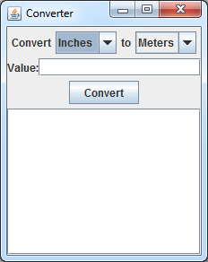

Touch-Up
JPanel panB = new JPanel(new BorderLayout(8,0));
panMain.setBorder(BorderFactory.createEmptyBorder(8,8,8,8));

Slide 9
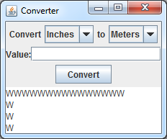
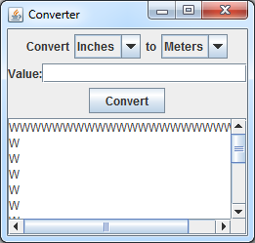
JScrollPane
Wraps a component
Automatically adds scroll bars
You can manually control the bars
panMain.add(BorderLayout.CENTER,history);
panMain.add(BorderLayout.CENTER,new JScrollPane(history));

Slide 10
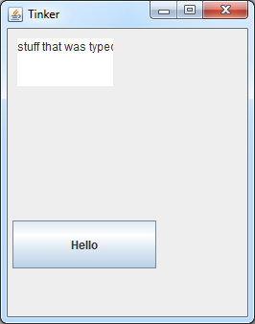
Absolutes
Preferred Size: as it would appear in a Flow
Size: the component’s current size
Location: x and y coordinate in the container
Minimum Size: smallest it can go
Maximum Size: large as it can go
JPanel pan = new JPanel(null); // NO LAYOUT MANAGER
pan.setPreferredSize(new Dimension(250,300));
JButton bt = new JButton("Hello");
//bt.setBounds(5,200,150,50);
bt.setSize(150,50);
bt.setLocation(5,200);
pan.add(bt);
JTextArea ta = new JTextArea();
ta.setBounds(10,10,100,50);
pan.add(ta);

Slide 11

JFrame
public static void main(String[] args) {
JFrame jf = new JFrame("My Frame");
jf.setIconImage( ... );
jf.setLocation(x, y);
jf.setSize(width, height);
jf.setBounds(x,y,width,height);
jf.setResizable(true);
jf.setMinimumSize( ... );
jf.setMaximumSize( ... );
jf.pack(); // Pack the layout
jf.setContentPane( ... );
jf.setVisible(true);
jf.dispose(); // Release OS
jf.setDefaultCloseOperation(JFrame.DISPOSE_ON_CLOSE);
}

Slide 12

JPanel
JPanel pan = new JPanel();
JPanel pan = new JPanel(new FlowLayout());
pan.setLayout(new BorderLayout());
pan.add(component);
pan.add(component, "Hi there!");
pan.add(component, BorderLayout.CENTER);
pan.setBorder( ... );

Slide 13

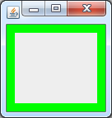
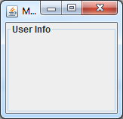
BorderFactory
JPanel pan = new JPanel();
pan.setBorder(BorderFactory.createEmptyBorder(8,8,8,8));
pan.setBorder(BorderFactory.createRaisedBevelBorder());
pan.setBorder(BorderFactory.createLineBorder(Color.GREEN,10));
pan.setBorder(BorderFactory.createTitledBorder("User Info"));

Slide 14
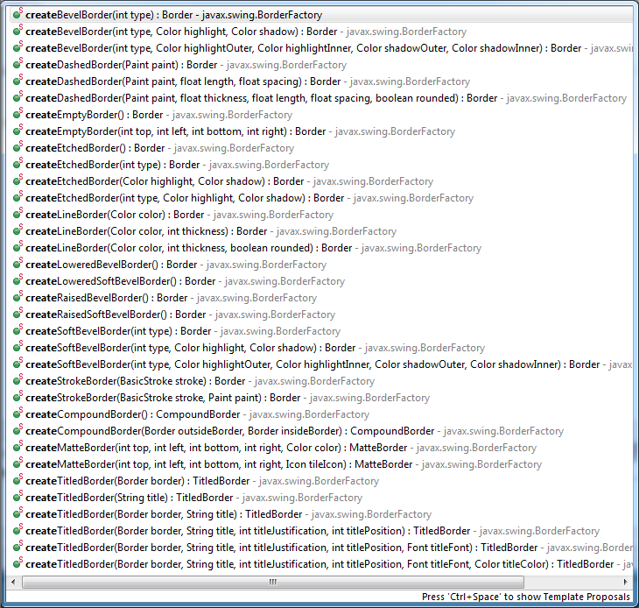

Slide 15
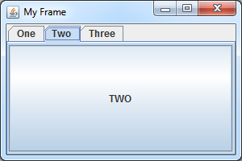
JTabbedPane
JFrame jf = new JFrame("My Frame");
JTabbedPane jtp = new JTabbedPane();
jtp.addTab("One", new JButton("ONE"));
jtp.addTab("Two", new JButton("TWO"));
jtp.addTab("Three", new JButton("THREE"));
jf.setContentPane(jtp);
jf.setSize(300, 200);
jf.setVisible(true);

Slide 16
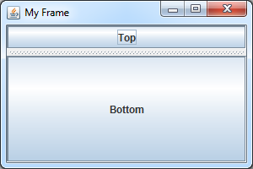
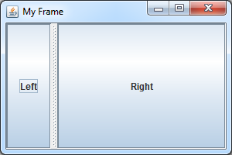
JSplitPane
JFrame jf = new JFrame("My Frame");
JSplitPane js = new JSplitPane(JSplitPane.VERTICAL_SPLIT,
new JButton("Top"), new JButton("Bottom"));
JSplitPane js = new JSplitPane(JSplitPane.HORIZONTAL_SPLIT,
new JButton("Left"), new JButton("Right"));
jf.setContentPane(js);
jf.setSize(300, 200);
jf.setVisible(true);

Slide 17

Tinkering
Type in the Flow, Border, and Grid layout examples.
Try the Converter example from scratch. Refer to the lesson slides if you get stuck.

